Slide 1


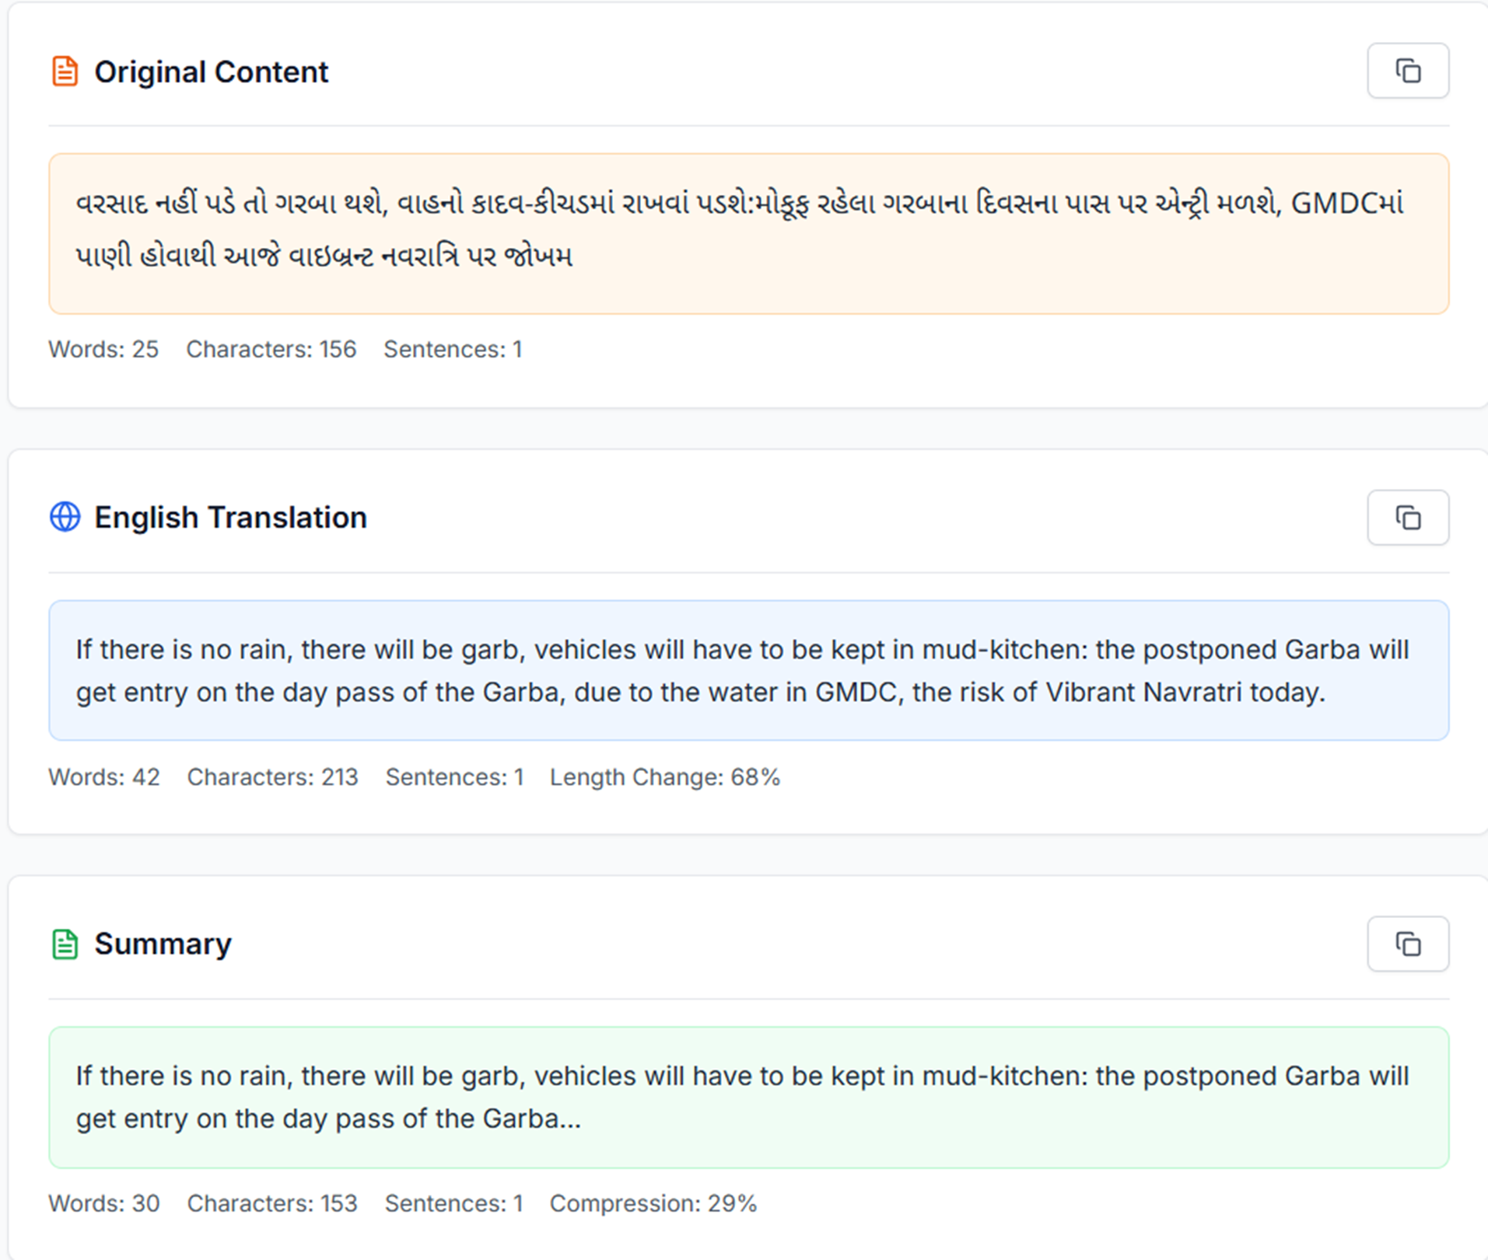
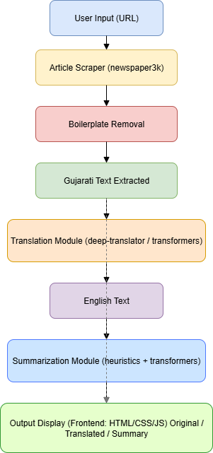
Poster for Natural Language Processing (202047809)
on
Gujarati News Translator & Summarizer Web App
Supervised by : DR . Priyang Bhatt
Prepared by: Prashant Kansara (12302130503003),Parth Kansara(12302130503008) Academic Semester:7, Year: 2025-26
Abstract
A lightweight backend service that ingests Gujarati news (URL or raw text), removes boilerplate (e.g., copyright/footer), translates content to English, and produces a concise extractive summary. Built with FastAPI and designed for serverless deployment (e.g., Vercel) without heavy ML dependencies.
Result
Introduction
Non-Gujarati audiences lack a fast, reliable way to extract Gujarati news articles, remove boilerplate, translate them to English, and obtain concise summaries. This project provides a scalable and lightweight solution suitable for serverless deployment on minimal resources.
Tech Stack
Frontend: React
Backend: FastAPI, Flask
NLP & ML: transformers, torch, newspaper3k, deep-translator.
Deployment: Vercel
References
[1] T. Wolf et al., “Transformers: State-of-the-Art Natural Language Processing,” in Proc. 2020 Conf. Empirical Methods in Natural Language Processing (EMNLP), 2020. [Online]. Available: https://huggingface.co/transformers
[2] A. Paszke et al., “PyTorch: An Imperative Style, High-Performance Deep Learning Library,” in Advances in Neural Information Processing Systems, vol. 32, 2019. [Online]. Available: https://pytorch.org
[3] Newspaper3k, “Article scraping and curation library.” [Online]. Available: https://newspaper.readthedocs.io
[4] Deep-Translator, “Python library for translations using multiple APIs.” [Online]. Available: https://pypi.org/project/deep-translator/
[5] S. Ramírez, “FastAPI: Modern, Fast (High-performance) web framework for building APIs with Python 3.6+.” [Online]. Available: https://fastapi.tiangolo.com
Conclusion & Applications
The project delivers a lightweight, serverless-ready system for Gujarati news translation and summarization, enabling non-Gujarati audiences to quickly access regional news. By integrating article scraping, boilerplate removal, translation, and summarization into a single pipeline, it ensures efficiency, low dependency overhead, and real-world usability.
Applications:
Cross-lingual News Monitoring: Track Gujarati news in English for journalists and organizations.
Media Analytics & Research: Provide quick digests for media houses, researchers, and policymakers.
News Aggregation & Alerts: Integrate into real-time pipelines for concise English updates.
Educational & Accessibility Use: Support students, non-native speakers, and global stakeholders in understanding Gujarati content.
System Architecture
Department of Computer Science
G H Patel College of Engineering and Technology

